Slide 1








Slide 2
MUSIC RECOMMENDER
SYSTEM
Saikiran
Kushagra K.
Pooja
Anu sumanth

Slide 3
ABOUT US
Background (B-tech or M-tech)
N . Saikiran - B.sc
Kushagra K. - B.Tech
Pooja Waykar - B.E.
Anu Sumanth - B.Tech
Why you want to learn Data Science
I want to have good skill, Data Science is having good demand, so taught its best option.
Since data science is a never ending field, and I always want to be an explorer thats why I chose data science.
I like to play with data and predict different output, thats why I choose Data Science.
Just Exploring what works for me.
Any work experience
Saikiran - No work Experience.
Kushagra - No work experience.
Pooja Waykar - No Work Experience.
Anu Sumanth - No Work Experience
What do we like you about Innomatics Research lab
The knowledge I gained , the experience is really invaluable. Kanav sir and all the mentors are really helpful.

Slide 4
CONTENTS
What is recommender system?
Types of recommender system
Exploratory data analysis
Popularity based Filtering
Content based Filtering
Collaborative Filtering
Final Improvements

Slide 5
WHAT IS RECOMMENDER SYSTEM?
Recommender system is a system to generate meaningful recommendations to a collection of users for items or products that might interest them.
For Example: Suggestions for books on Amazon, movies on Netflix and more.
A recommender system is a subclass of information filtering systems that seeks to predict the "rating" or "preference" a user would give to an item.

Slide 6
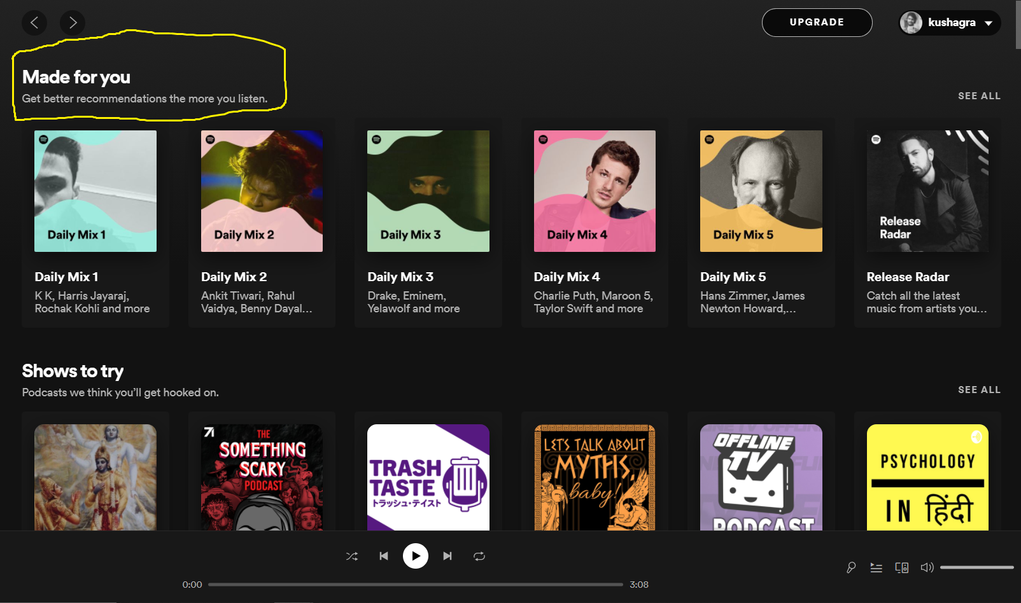
This is my Spotify account and their recommendation.

Slide 7
TYPES OF RECOMMENDATION SYSTEM
In our Music recommendation system we use the following system :
Popularity Based Recommender System
Content Based Recommender System
Collaborative Based Recommender System
Matrix Filterization (SVD)
Hybrid Recommender System

Slide 8
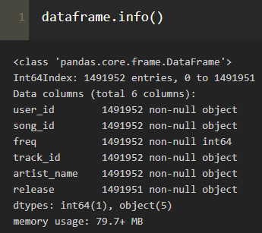
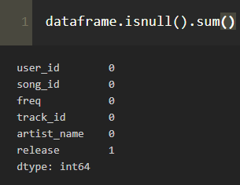
GIST FROM EXPLORATORY DATA ANALYSIS
Dataset contains the following columns :
Song ID : Unique identifier
of each song.
Frequency : Number of times the
particular song listened
User ID : Unique identifier for
each user.
Track ID : Unique identifier of
tracks.
Artist : Artist/Singer of the
particular song.
Release : Release of each song.
We have 110000 unique user_id.
The data contains 5 object type and 1 integer type column.

Slide 9
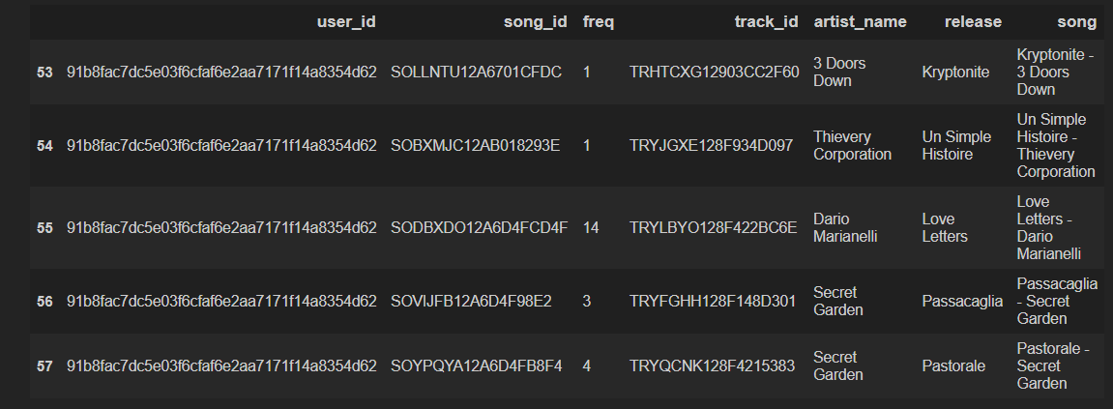
DATAFRAME:

Slide 10
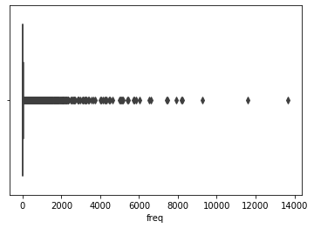
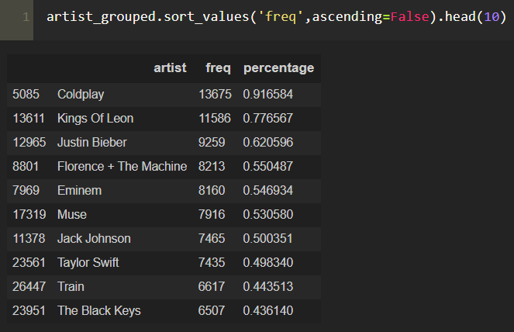
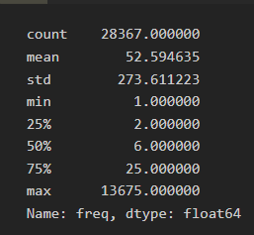
Top 10 most listened Artist:
We can see mode of the listened column is 1.
The distribution is highly skewed

Slide 11
EXPLORATORY DATA ANALYSIS OBSERVATIONS
There are 1,10,000 unique users, 1,37,674 unique releases, 28,367 unique artists.
There are total 137674 songs from all artists.
Most listened artist is “Coldplay” for the song “Yellow”.
Artists with highest popularity are very less.
Most listened song is “Sher Kosmisch”. This is listened 5043 times by all users.
One user listened “Drop the Hammer” song 923 time.
Two user were listened to 57 songs.

Slide 12
POPULARITY BASED
It is a type of recommendation system which works on the principle of popularity and or anything which is in trend. These systems check about the product or song which are in trend or are most popular among the users and directly recommend those.
Example
Google News
YouTube

Slide 13
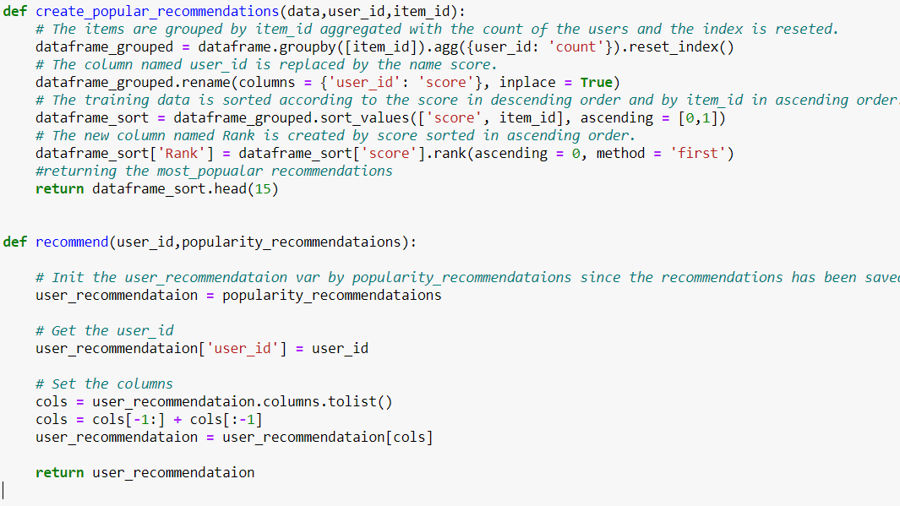
CODE AND EXPLANATION

Slide 14
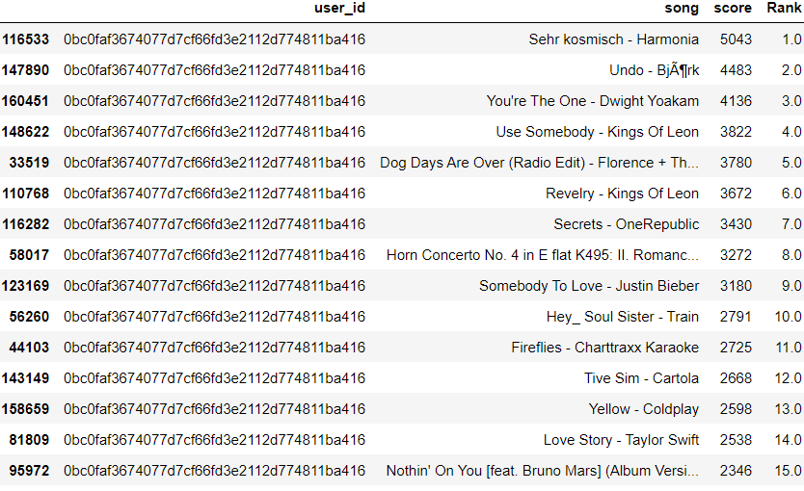
OUTPUT

Slide 15
Merits and Demerits of Popularity Based Recommendation System
Merits :-
It does not suffer from cold start problems.
No need for the user's historical data.
Demerits :-
Not personalized
System would recommend the same sort of products/songs.

Slide 16
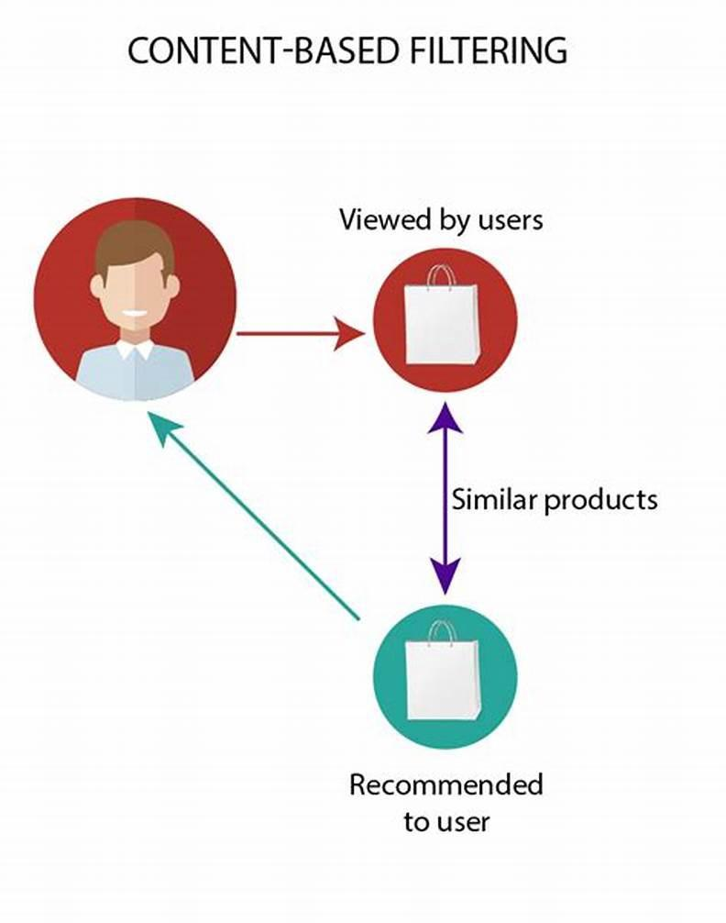
CONTENT BASED
Content-based filtering is using the technique to analyze a set of documents and descriptions of items previously rated by a user and then build a profile or model of the user’s interests based on the features of those rated items.

Slide 17
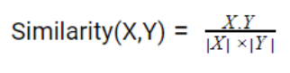
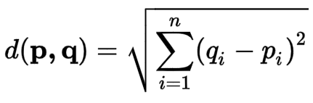
Following is the most widely used similarity score concepts:
Cosine Similarity :
Cosine of the angle between the two vectors of the item, vectors of A and B is calculated for imputing similarity. If the vectors are closer, then small will be the angle and large will be the cosine.
Euclidean distance :
The Euclidean distance between two points in Euclidean space is the length of a line segment between the two points. Where p and q are our vectors , which are nothing but content.

Slide 18
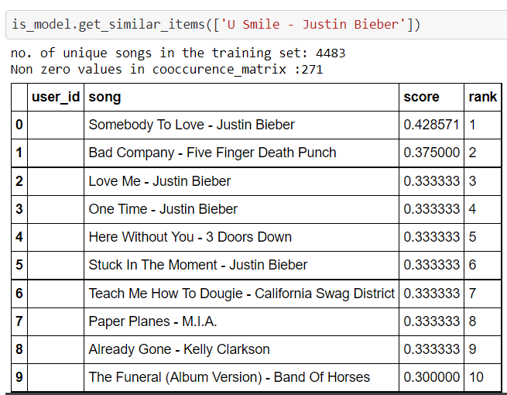
GETTING SIMILAR SONGS

Slide 19
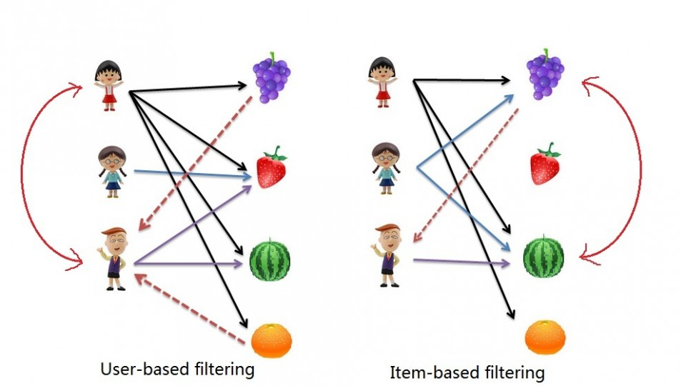
COLLABORATIVE BASED
Collaborative filtering filters information by using the interactions and data collected by the system from other users. It's based on the idea that people who agreed in their evaluation of certain items are likely to agree again in the future.
There are two types of
Collaborative system:
User Based
Item Based

Slide 20
User-based :
Item’s recommendation rating for a user is calculated depending on that items’ ratings by other similar users.
Similarity is based upon similarity in users’ purchasing behaviour.
“User x is similar to user y because both purchased items A, B and C.
Item-based :
Item’s rating is predicted based on how similar items have been rated by that user.
Similarity is based upon co-occurence of purchases.
“Items A and B were purchased by both users x and y, so they are similar.”
There are two ways with which we have used collaborative Filtering :
CF using cooccurrence matrix
CF using Matrix Factorization (using surprise library)

Slide 21

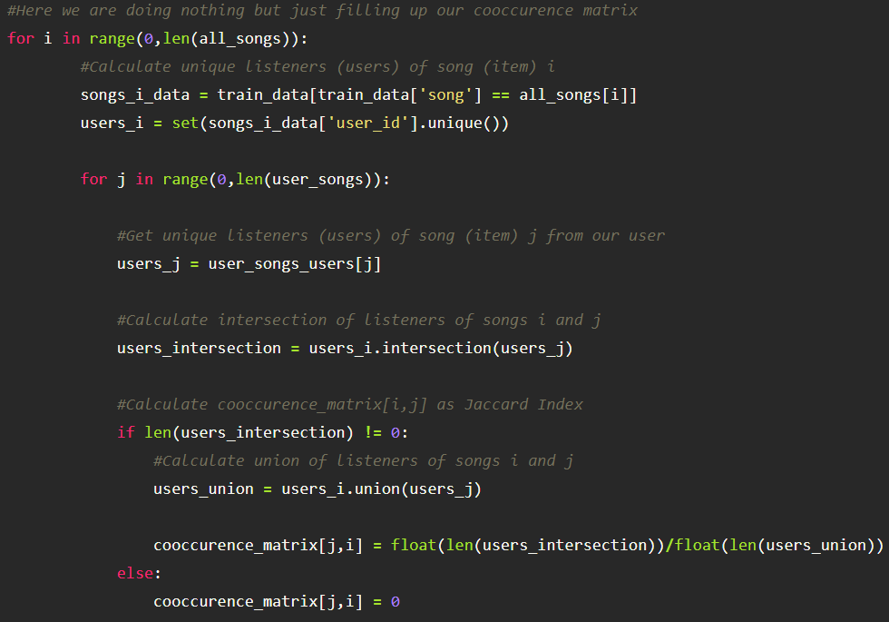
COOCCURRENCE
MATRIX
CREATION
For creating our cooccurrence Matrix

Slide 22
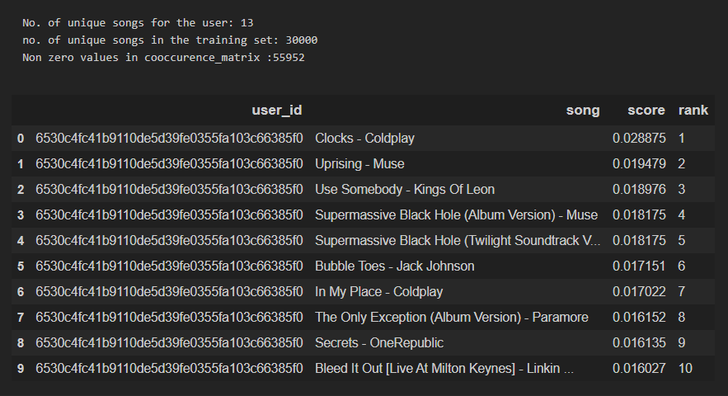
Recommendation to random user:

Slide 23
FINAL IMPROVEMENTS
Even though the Item - Item collaborative system works well but took a very long time to create the cooccurence matrix for our data.
There was no measure of how well our collaborative or content based worked well or not.
To overcome this problem :
We used the surprise library which also helped in evaluating our model.
Using predefined functions such as SVD , KNN , Baseline which are way more faster than simply creating cooccurence.
Using Hybrid Filtering which uses both content based and Collaborative filtering prevent flaws in both methods.

Slide 24
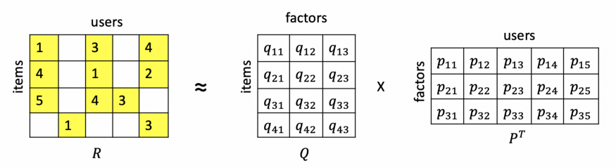
MATRIX FILTERIZATION
Matrix Factorization is a powerful way to implement a recommendation system. The idea behind it is to represent users and items in a lower-dimensional latent space.
So, in other words, Matrix factorization methods decompose the original sparse user-item matrix into lower dimensionality less sparse rectangular matrices with latent features.
Among the different matrix factorization techniques, we found the popular singular value decomposition (SVD).

Slide 25
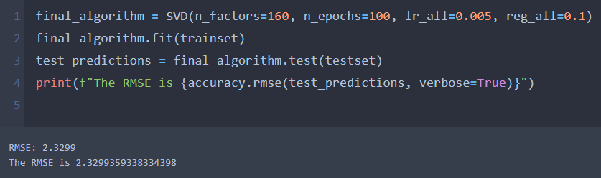
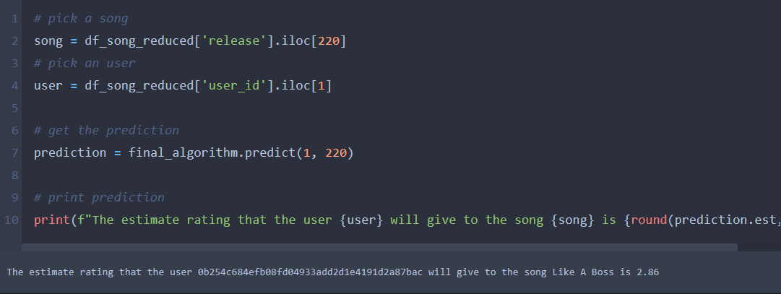
Training using SVD as our model
Estimating rating given by the user to a random song.

Slide 26
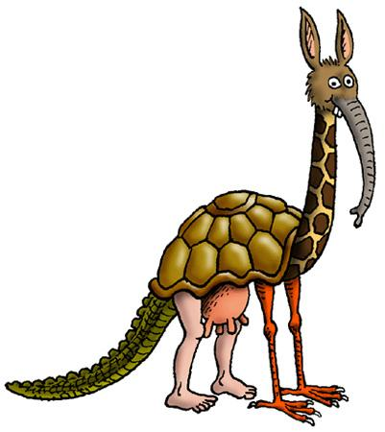
HYBRID SYSTEM

Slide 27
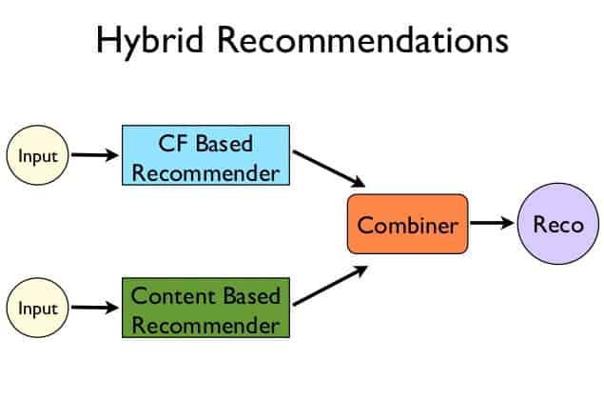

Slide 28
Most recommender systems now use a hybrid approach, combining collaborative filtering, content-based filtering, and other approaches .
There is no reason why several different techniques of the same type could not be hybridized. Hybrid approaches can be implemented in several ways: by making content-based and collaborative-based predictions separately and then combining them; by adding content-based capabilities to a collaborative-based approach (and vice versa); or by unifying the approaches into one model (see for a complete review of recommender systems).
Several studies that empirically compare the performance of the hybrid with the pure collaborative and content-based methods and demonstrated that the hybrid methods can provide more accurate recommendations than pure approaches.
These methods can also be used to overcome some of the common problems in recommender systems such as cold start and the sparsity problem, as well as the knowledge engineering bottleneck in knowledge-based approaches.

Slide 29
Netflix is a good example of the use of hybrid recommender systems. The website makes recommendations by comparing the watching and searching habits of similar users (i.e., collaborative filtering) as well as by offering movies that share characteristics with films that a user has rated highly (content-based filtering).
Some hybridization techniques include:
Weighted: Combining the score of different recommendation components numerically.
Switching: Choosing among recommendation components and applying the selected one.
Mixed: Recommendations from different recommenders are presented together to give the recommendation.
Feature Combination: Features derived from different knowledge sources are combined together and given to a single recommendation algorithm.
Feature Augmentation: Computing a feature or set of features, which is then part of the input to the next technique.
Cascade: Recommenders are given strict priority, with the lower priority ones breaking ties in the scoring of the higher ones.
Meta-level: One recommendation technique is applied and produces some sort of model, which is then the input used by the next technique

Slide 30

THANK YOU

